Slide 1
IIT RopAr APP
Naman Goyal (2015csb1021)
Sarthak Gupta (2015csb1029)
Vishal Singh (2015csb1040)
Nittin Singh (2015csb1067)

Slide 2
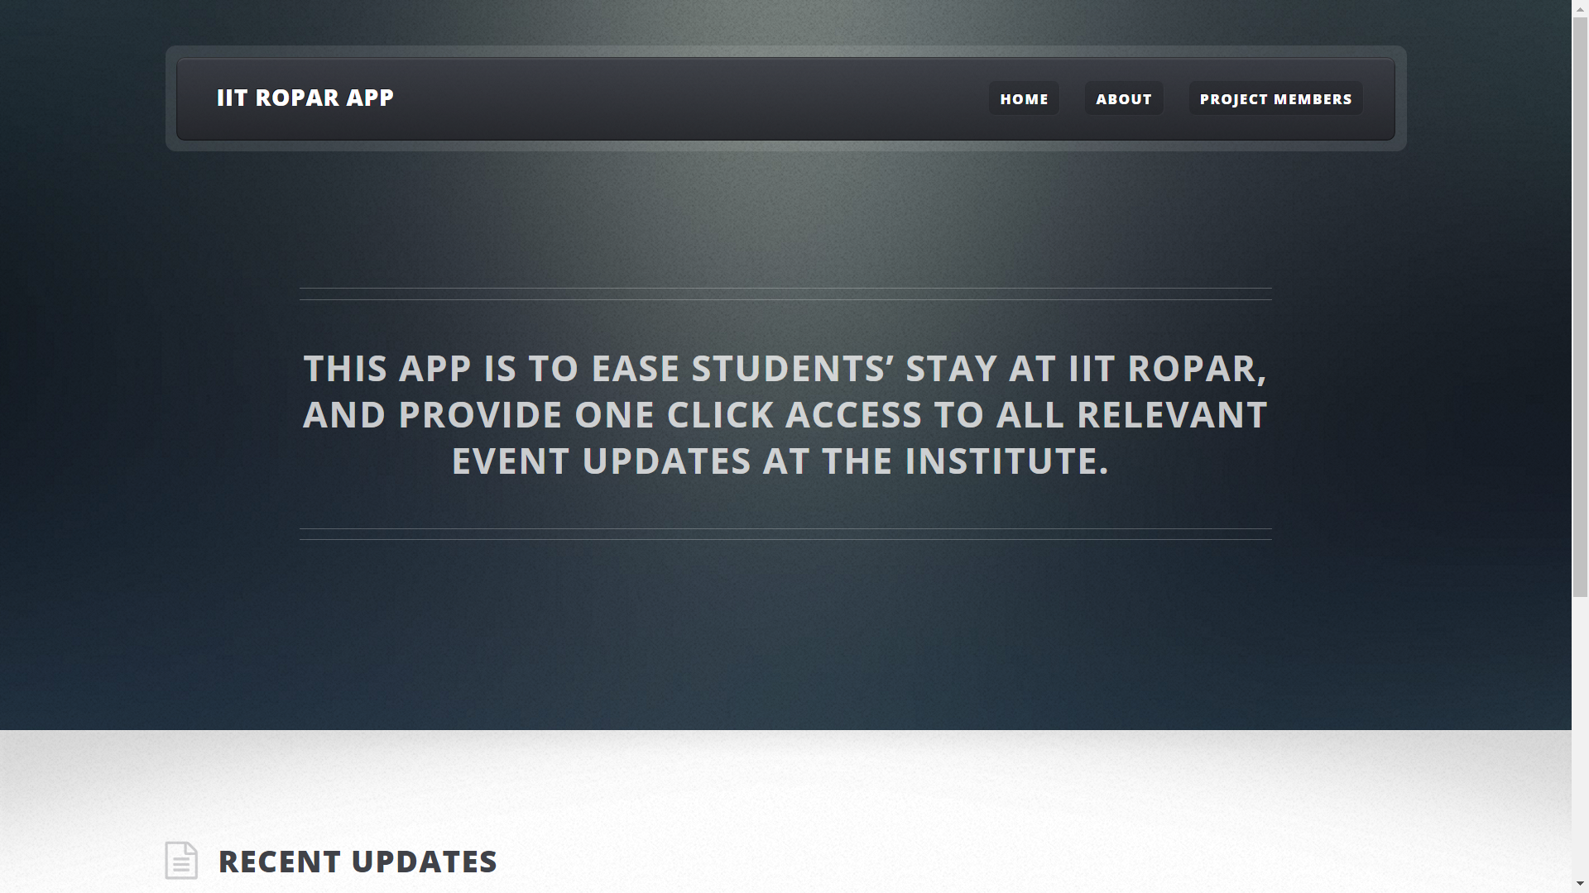
idea
http://10.1.1.19/~2015csb1040

Slide 3
Current progress
https://github.com/namangoyal6/csp203

Slide 4
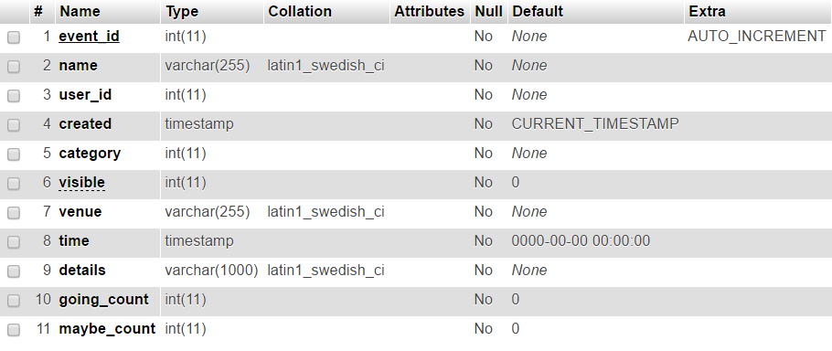
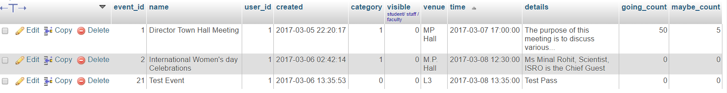
Events table

Slide 5
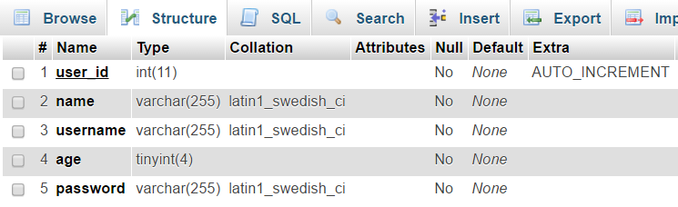
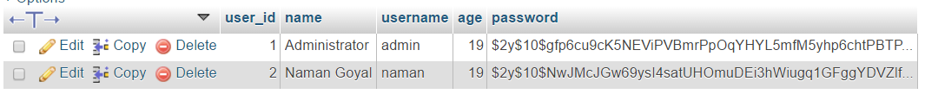

USERS table

Slide 6
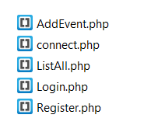
PHP Scripts

Slide 7
Design Expected

Slide 8
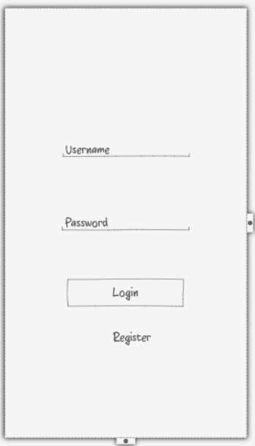
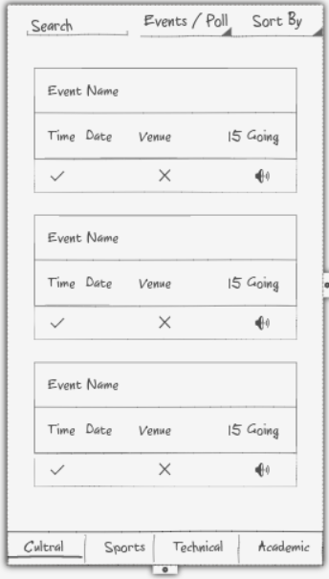
List All Events

Slide 9
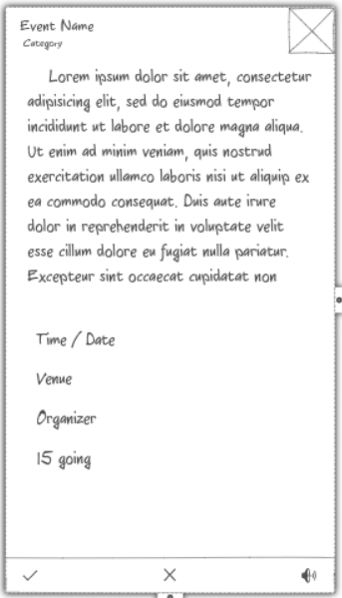
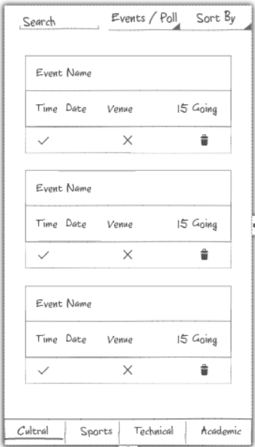
User
Mode

Slide 10
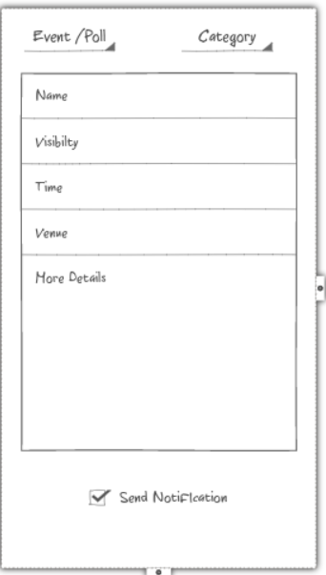
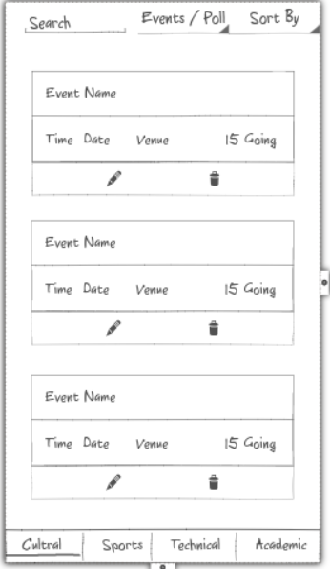
Organizer
Mode

Slide 11
Live demo

